Slide 1


Slide 2


Slide 3
What is Angular
Why Angular
Architecture of Angular 2 Apps
Getting Started with Angular

Slide 4

Angular is a development platform for building mobile and desktop web applications.

Slide 5
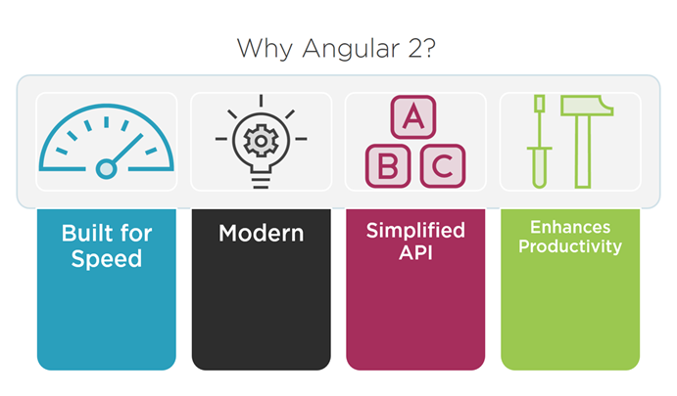

Slide 6
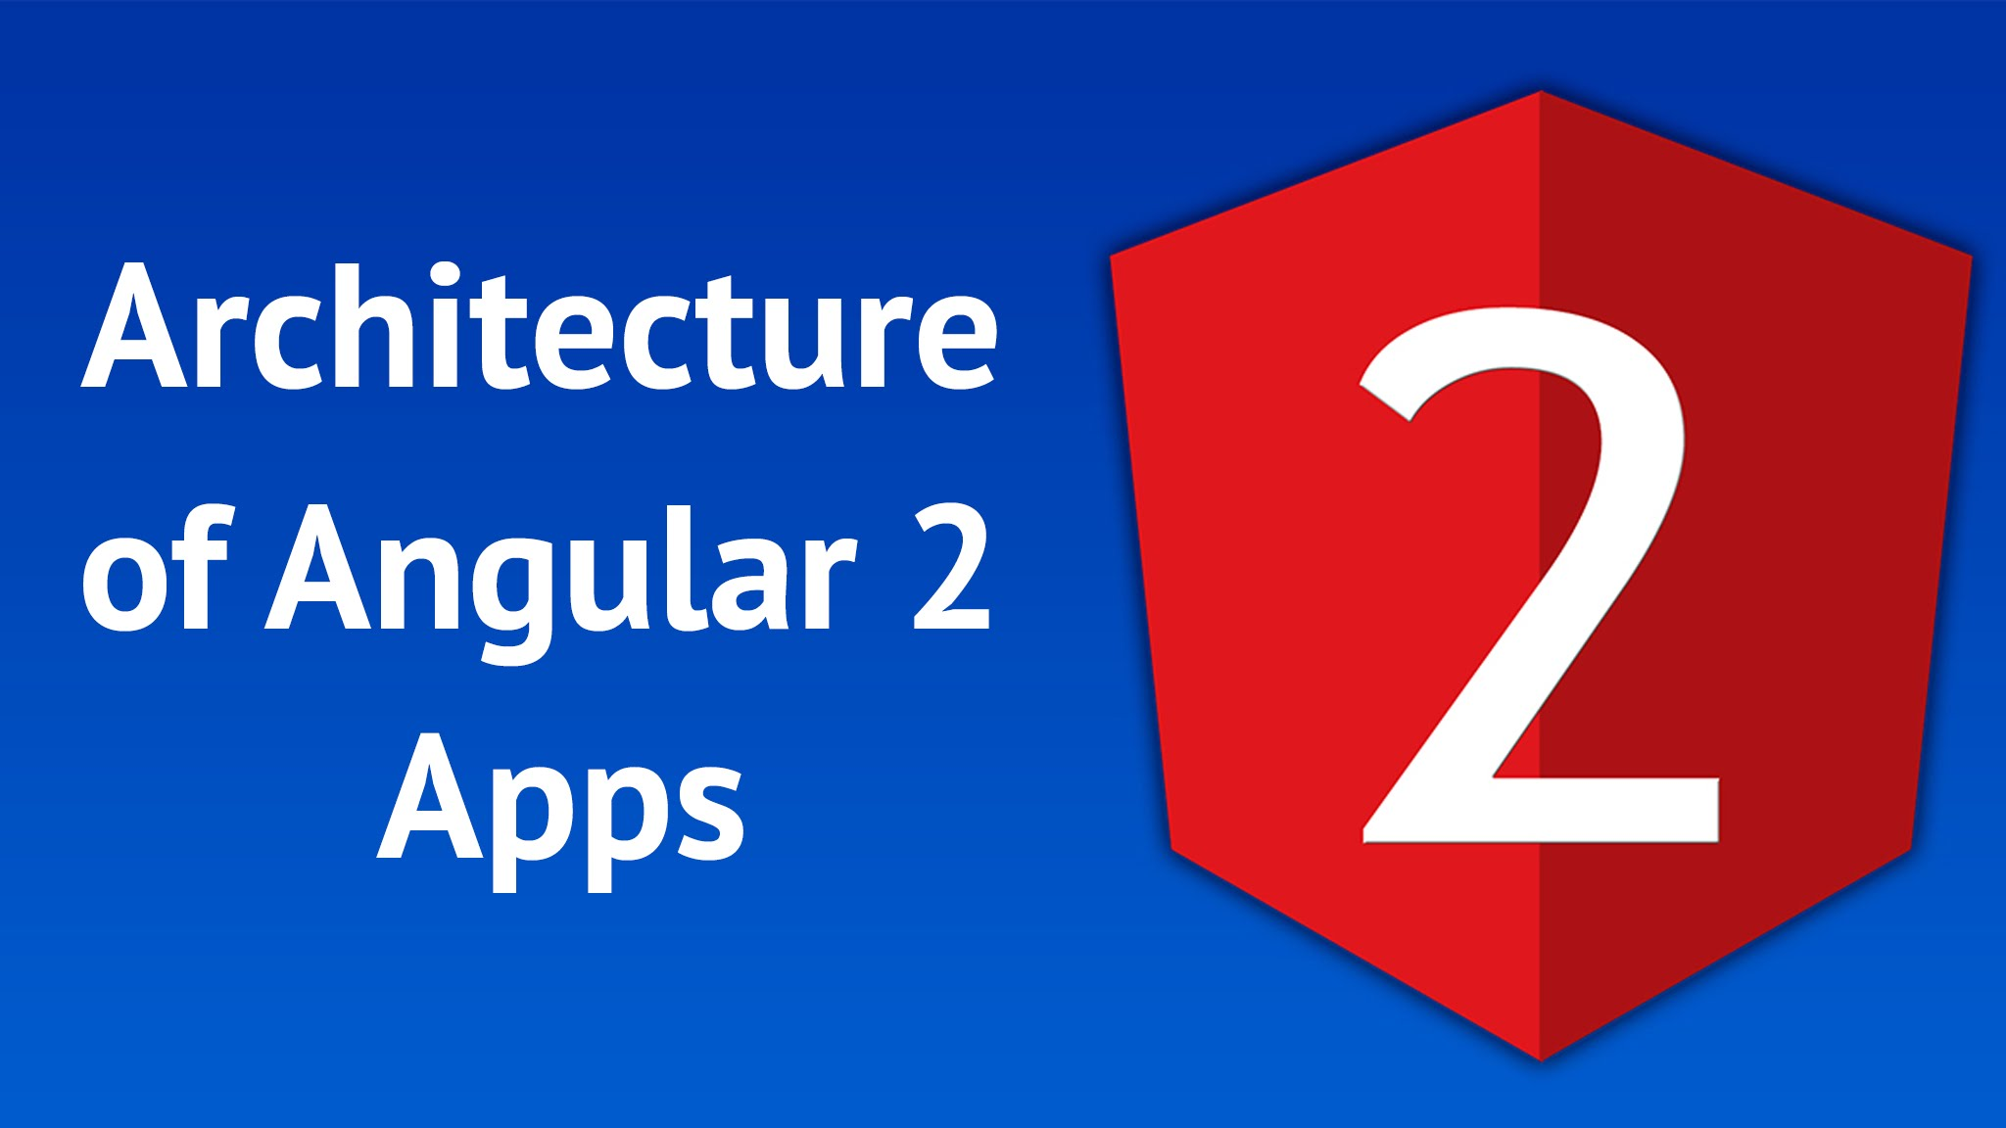

Slide 7
8 Main Parts
Module
Component
Template
Metadata
5. Data Binding
6. Service
7. Directive
8. Dependency Injection

Slide 8
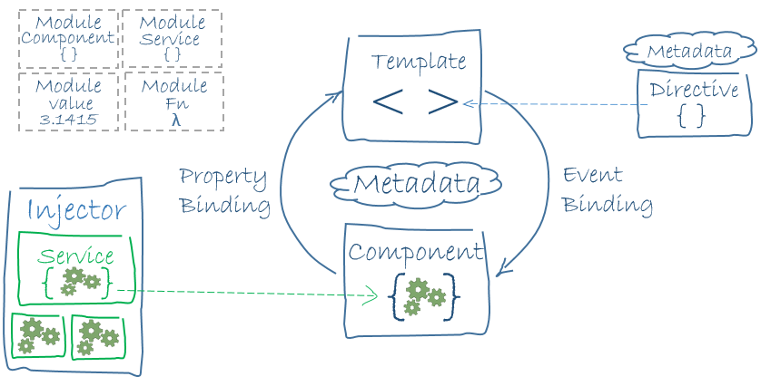

Slide 9


Slide 10
What is TypeScript

Slide 11
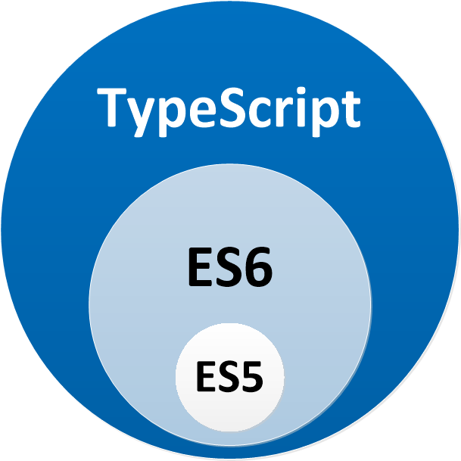

Slide 12
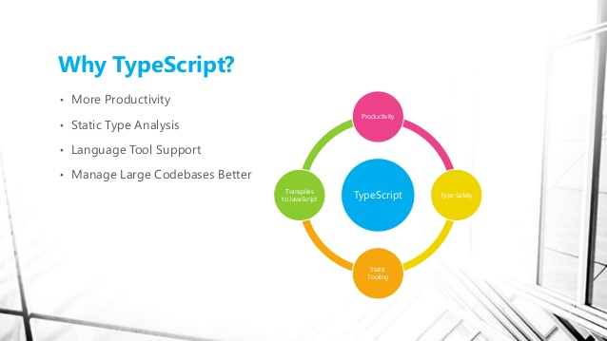

Slide 13
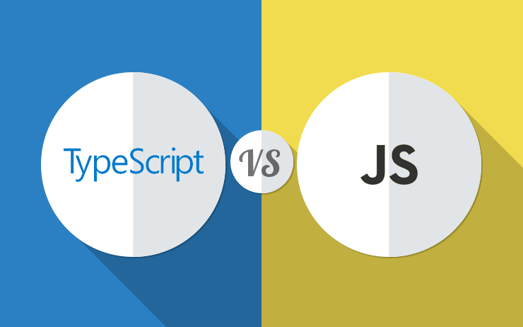

Slide 14
